Slide 1
Tweets Analysis Based On Big Data Technology
Jiechen Han & Quan Yang
CS 523 Prof. Mrudula Mukadam

Slide 2
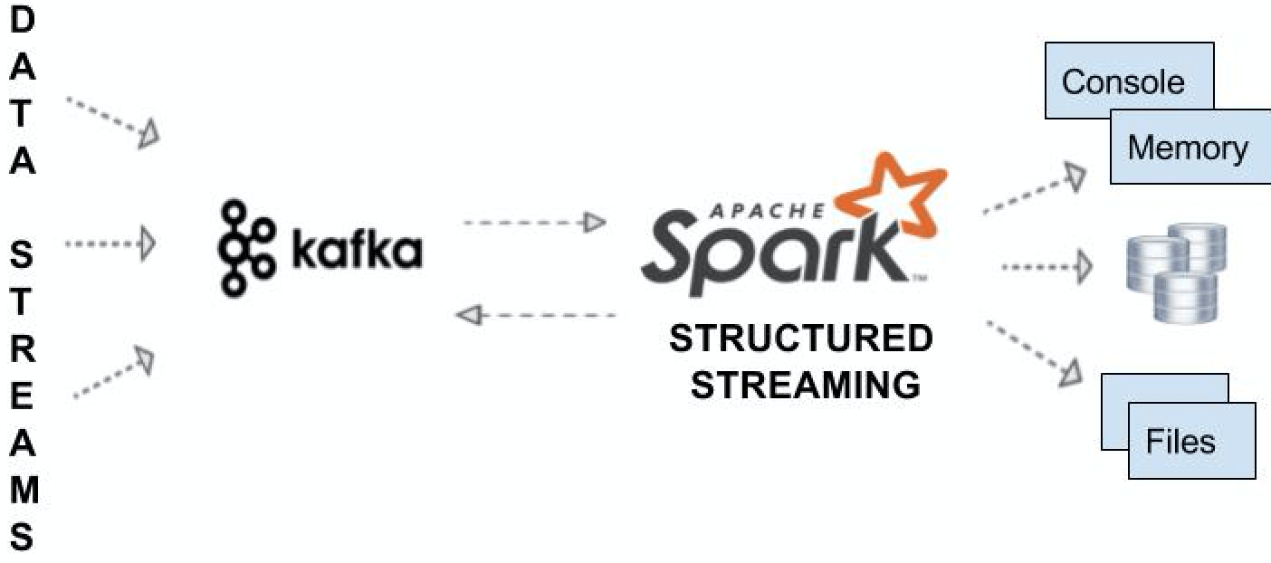
System Architecture

Slide 3
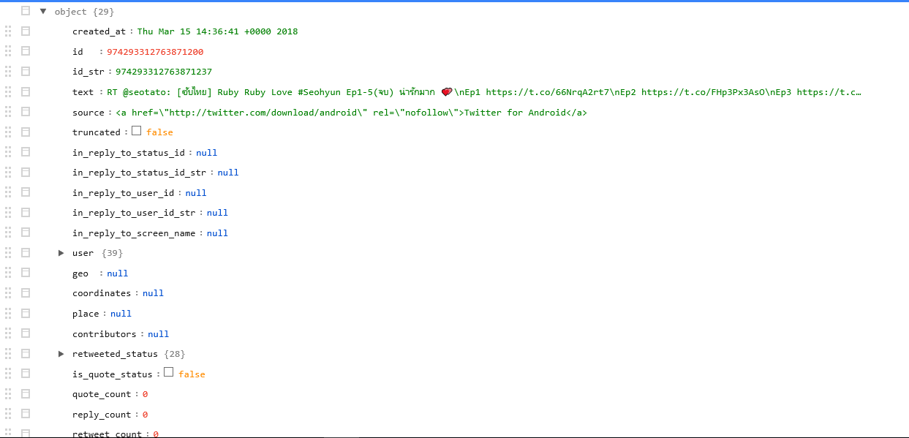
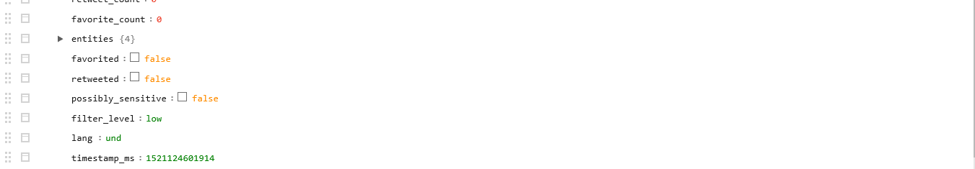
Tweet Object Example

Slide 4
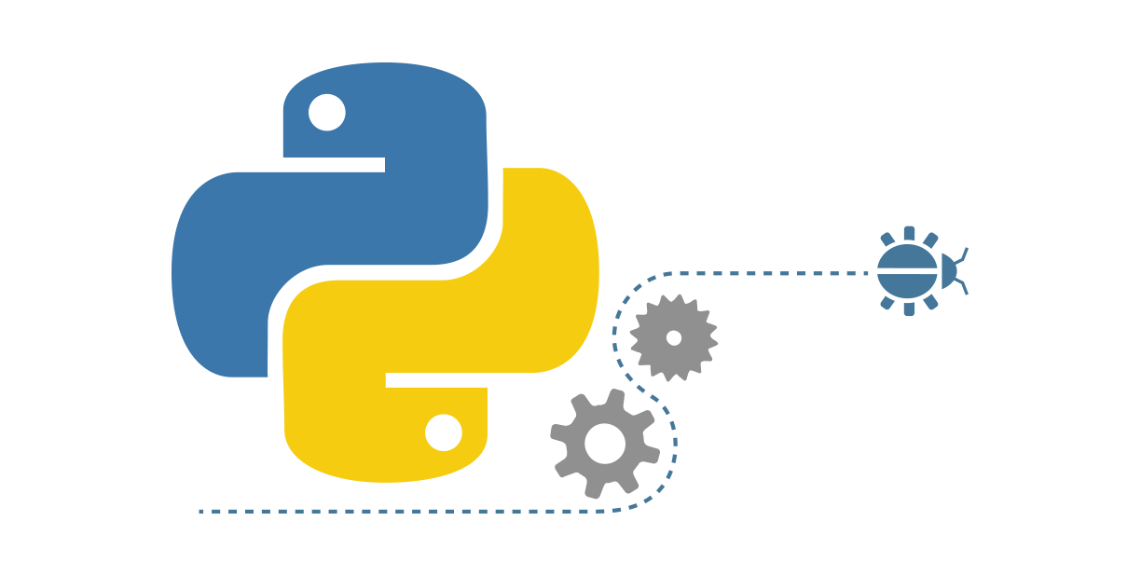





Tweets Object Processing Pipeline
Consumer Key (API Key)
Consumer Secret (API Secret)
Access Token
Access Token Secret
Tweepy
Spark SQL
SQL + DataFrames
Spark
Streaming

Slide 5
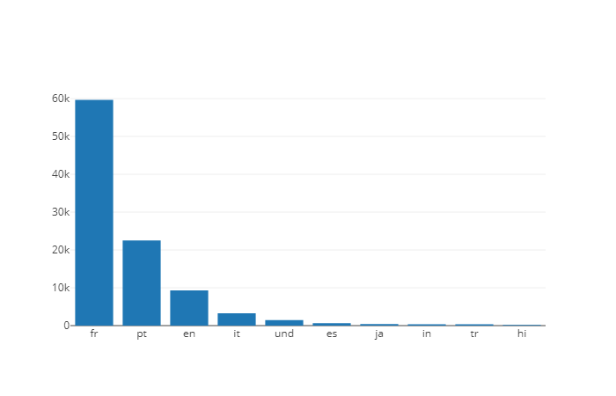
Analysis Results (1) ------Top10 Languages in every 10 seconds

Slide 6
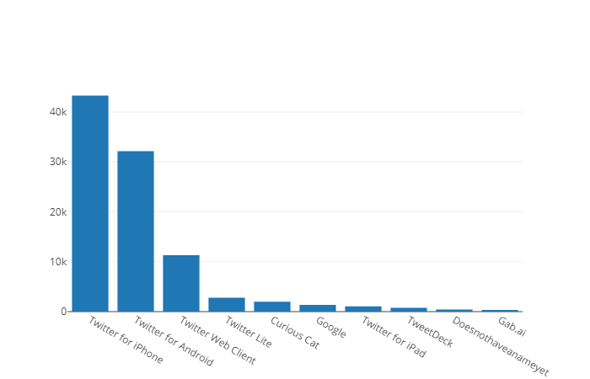
Analysis Results (2) ------Top10 Sources in every 10 seconds

Slide 7
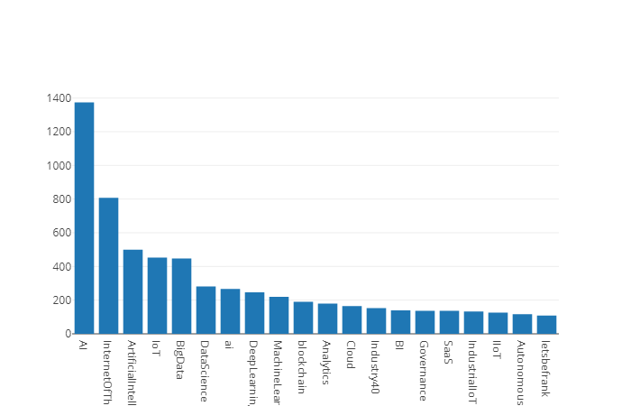
Analysis Results (3) ------Top20 Topics in every 10 seconds

Slide 8
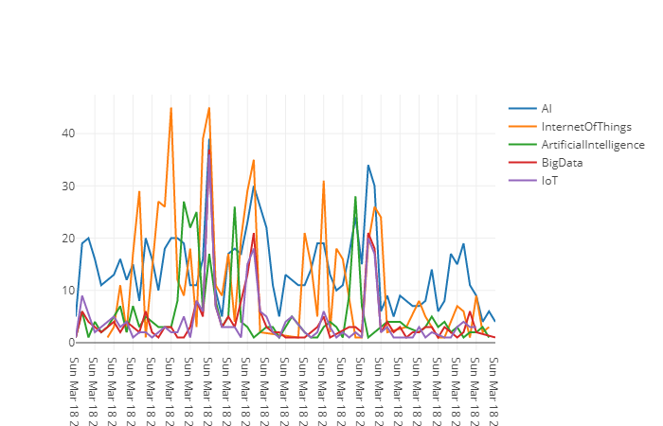
Analysis Results (4) ------Topics Trend in more than one hour

Slide 9


